Slide 1
ISP OBI Project
Mechanistic Modeling of the KCNQ2 R581Q Mutation in Mouse and Human Layer 5 Pyramidal Neurons
By: Rubaisha Ahmed, Simel Masood, Koelgeet Kaur, Mehreen Mansoor, Kumail Haider, and Siddharth Kashyap

Slide 2
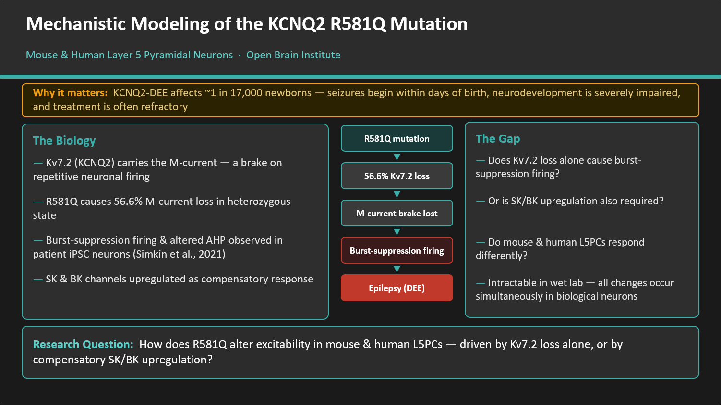

Slide 3


Model and Data Resources
Two validated L5PC e-models, neither containing Kv7.2 — and the data used to build and validate it.
NEURON MODELS · simulation targets
REFERENCE DATA · Simkin et al., 2021
MOUSE · Open Brain Institute
Mouse/rat L5PC, cADpyr e-type
EM__sscxrat__cADpyr_L5TPC__0 — reconstructed morphology plus ion-channel mechanisms fitted by multi-objective optimisation.
Role: cross-species generalisation test
CHANNEL LEVEL · CHO cells, 35°C
Kv7.2/Kv7.3 voltage clamp
WT and R581Q → current density, V½, slope factor k, activation τ.
Role: constrains the Hodgkin-Huxley Kv7.2 fit
HUMAN · Blue Brain Project
Human L5PC, cADpyr e-type
BluePyOpt l5pc optimisation example — github.com/BlueBrain/BluePyOpt
Role: direct validation target for Simkin et al. firing data
NEURON LEVEL · iPSC-derived cortical neurons
Current clamp, patient vs isogenic control
R581Q → AP half-width, fAHP / mAHP / sAHP, RMP, burst-firing metrics.
Role: ground-truth phenotype the model must reproduce
PLATFORM & TOOLS
Open Brain Institute
Blue Brain Project (Human L5PC and eFEL Library)
Jupyter Notebooks and Colab Pro
Model building, simulation campaigns, parameter sweeps
Human L5PC model and supporting libraries
For further Analysis
Electrophysiology feature extraction from simulated traces
Mechanistic Modelling of R581Q Mutation in Human and Mouse L5PCs
Aman Ki Aasha
Notes:
Model and Data Resources. Left: the two OBI/Blue Brain L5PC e-models we extend - neither ships with Kv7.2, which is exactly the gap Task 1 fills. Right: Simkin et al. (2021) supplies both halves of the evidence - CHO voltage-clamp data to fit the channel, and iPSC current-clamp data to validate the resulting firing phenotype. Bottom: everything is built and analysed on the OBI platform with eFEL for feature extraction.

Slide 4
Methodology
Channel Level Validation
Single-Cell Excitability Features
Fit the Kv7.2 model to CHO voltage-clamp data using OBI's multi-objective evolutionary algorithm, which optimizes V½, k, and τ simultaneously across all recorded voltage steps (−60 to +40 mV), rather than fitting one voltage at a time.
Extracted via eFEL from control and mutant current-clamp simulations:
Rheobase
Input resistance
AP amplitude
Fast AHP
Slow AHP
ISI CV
F-I gain
AP threshold
Medium AHP
Spike-frequency adaptation
Burst index
Fit quality assessed via:
Residuals per voltage step
Activation curve (G-V) comparisons
τ (activation time constant) vs. voltage comparisons
Sanity checks on final V½, k, τ against biophysical bounds

Slide 5
Methodology
Sensitivity Analysis:
Cross-Species Comparison
factorial gₖᵥ₇.₂ × g_{SK} × g_{BK} sweep
Identical stimulus, temperature, and channel models applied to mouse and human. % change computed per species and compared directly:
Δ feature (%) = (feature_mutant − feature_WT) × 100 ………………………………………...feature_WT
Channel | Values swept | Source
g_Kv7.2 | 100% (WT), 70%, 43% (R581Q), 20% | 43% = current density reduction, Simkin et al. Fig. 1B; 70%/20% exploratory
g_SK | 100% (WT), ~122% (wk3, KCNN4), ~116–139% (wk5, KCNN1/KCNN2) | qPCR fold-change, Simkin et al. Fig. 4 source data
g_BK | 100% (WT), ~117% (wk3, KCNMA1), ~123% (wk5, KCNMB3) | qPCR fold-change, Simkin et al. Fig. 4 source data
Model-to-Experiment Validation
Simulated AP half-width, fAHP, mAHP, sAHP, RMP, and input resistance benchmarked against Simkin et al. (2021, Table 1) at a single consistent timepoint (week 5).

Slide 6
Work Plan
Month 1
Months 3–4
Months 5–6
Setup
Model integration
Mechanism test
OBI model inspection
and data preparation
HH formulation for other
ion channels
Mouse/human L5PC integration
Factorial Kv7.2/SK/BK sweep
Cross-species analysis
1
2
3
4
5
Months 2–3
Months 4–5
Kv7.2 channel
Phenotype test
Build WT and R581Q models
Channel-level validation
Fit to Simkin et al. data using OBI
multi-objective EA
Reproduction and validation
of the mutant phenotype
Mechanistic Modelling of R581Q Mutation in Human
Aman Ki Aasha

Slide 7
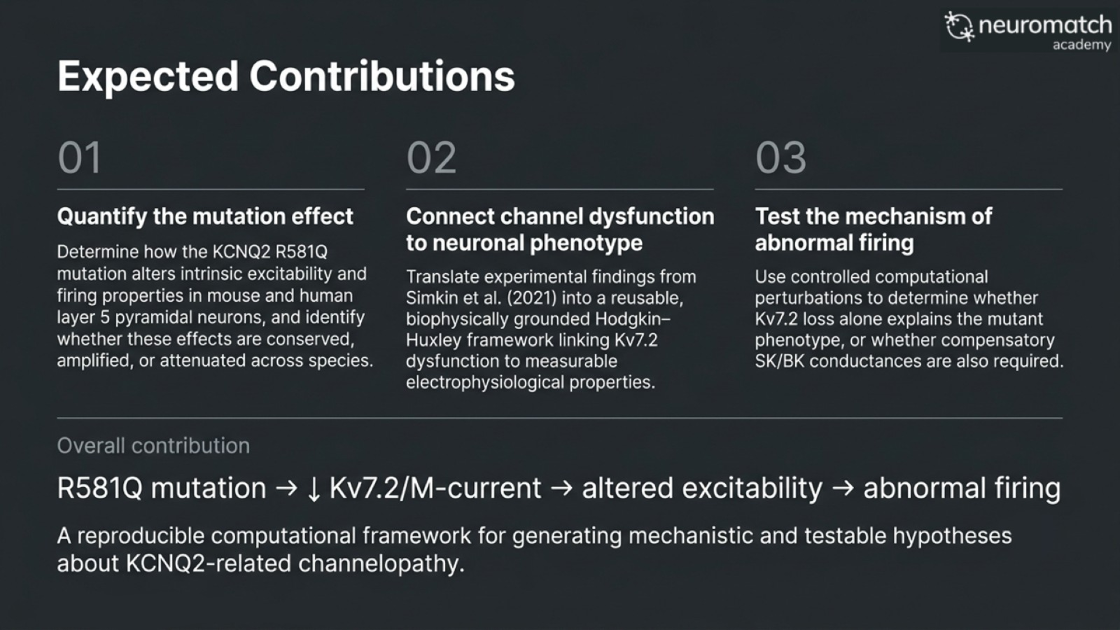

Slide 8
Thank You !

